Slide 1


Transformer-based Topic Modeling
Natural Language Processing
Student: Hengameh Shah Ali
40307604

Slide 2
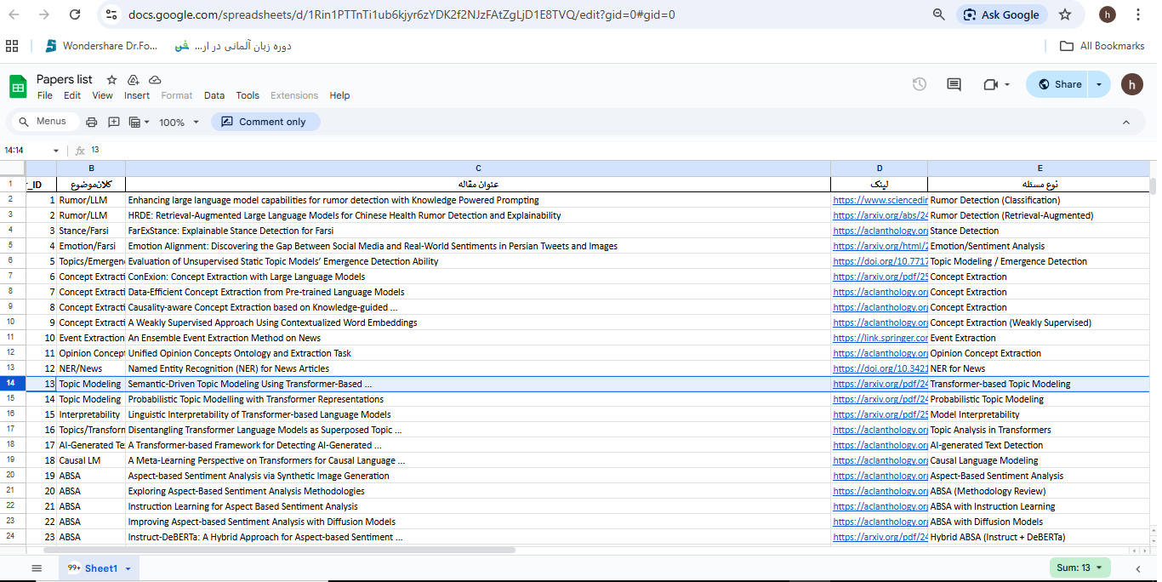
Transformer-based Topic Modeling

Slide 3

Problem Definition
Topic Modeling is one of the key challenges in Natural Language Processing (NLP), aiming to automatically discover hidden topics within a large collection of unlabeled textual documents. This emerging approach leverages transformers to provide a deeper understanding of textual content. In this model, each document is considered a mixture of multiple topics, and each topic is represented as a distribution over words/concepts. This approach helps uncover the latent semantic structure within vast amounts of textual data.
Transformer-based Topic Modeling is a novel method based on transformer architectures for discovering hidden topical patterns in large text collections. Thus, the core problem is extracting the thematic structure from texts without requiring labeled data, while achieving deep semantic understanding and high interpretability.
How can the latent thematic structures within a large collection of textual documents be automatically
discovered, organized, and interpreted, while simultaneously:
Eliminating the need for manual labeling,
Preserving deep, context-dependent meaning,
Accounting for complex relationships between words and concepts, and
Ensuring scalability for massive datasets?

Slide 4
The Historical Evolution of NLP
The Statistical Era (2000–2010) LDA, pLSA, NMF
The Embedding-Based Era (2010–2018) Word2Vec + Clustering
The Transformer Revolution (2018–Present) Transformer-based Topic Modeling Combining BERT's deep contextual understanding with advanced clustering techniques.

Slide 5
Comparison of Transformer-based Methods with Classical Methods
Roots: From Classical Models to the Need for Innovation
In Transformer-based Topic Modeling, powerful language models such as BERT are used to extract deep semantic representations (Semantic Embeddings). This approach transforms the problem from analyzing word co-occurrence to clustering concepts in semantic vector space.
Classical Methods (e.g., LDA, PLSA, NMF) | Transformer-based Methods
Bag-of-Words-based modeling | Based on deep textual semantics while considering word context
Treating words independently | Modeling inter-word relationships (Self-Attention)
Requires a predetermined number of topics | Automatic topic extraction
Poor performance on short, multilingual, and specialized texts due to a lack of deep semantic understanding | Effective for both long and short texts

Slide 6
Significance and applications
Significance:
Enhancement of topic extraction quality
Ability to distinguish between different usages of a word
Reduction in the need for human intervention
Elimination of the need for predefined keyword lists
Scalability for massive datasets
Capability to process millions of documents
Application Example | Context
Identifying market trends from news and social media | Marketing and Market Research
Tracking significant topics in the news | Media monitoring
Automated categorization of support tickets | Customer Support
Automated categorization of documents, emails, and reports | Organizational knowledge management
Discovering emerging research fields from scientific articles | Scientometrics

Slide 7
Importance and key transformations introduced
Transformer-based Topic Modeling has introduced profound transformations in how texts are understood and analyzed
Multilingual
Short texts
Understanding meaning
Native capability for effectively localizing and analyzing multilingual texts without requiring separate models
Significantly stronger performance in analyzing short texts, which was a major weakness of classical models
Transition from word-level to concept-level understanding, with greater accuracy and depth
Scalability
Interpretability
Capability to scale for processing organizational data and vast volumes of text
Providing results with higher interpretability, which is critical for decision-making

Slide 8







Real-world examples
This technology is utilized across various industries and helps organizations gain valuable insights from their textual data
Media and social network analysis
Telco and Tech-Co
Organizational document analysis
Discovery of trends, narratives, and media crises; monitoring of public opinion. Example: Bloomberg and Reuters
Analysis of customer complaints, support tickets, and call center conversations; discovery of recurring network issues and hidden grievances. Example: Vodafone and Telefónica
Automatic categorization of reports, resolutions, and administrative correspondence; discovery of key policy-making topics
Customer feedback and market analysis
Health, legal, and finance
Review Mining and Voice of the Customer (VoC). Example: Amazon Review Analysis and Airbnb Feedback Mining
Analysis of medical articles, judicial opinions, and financial reports. Example: PubMed Topic Discovery and Legal Case Clustering
In classical models, "bank loan," "credit facilities," and "financial lottery" were treated as separate topics
With transformers, these concepts are identified as a single topic: financial services, due to their semantic similarity

Slide 9
Practical Applications of Transformer-based Topic Modeling
Advanced and intelligent content analysis systems
Advanced social media monitoring and analysis platforms such as Brandwatch and NetBase Quid, aimed at achieving a more nuanced and informed understanding of conversations.
Intelligent customer support and complaint analysis systems
These systems can extract complex topics and subtopics from textual conversations (chat, email).
Semantic search engines and organizational knowledge management systems
Next-generation research systems and digital libraries
Scientific databases such as Semantic Scholar and arXiv, designed for recommending articles with related concepts.
Cybersecurity monitoring platforms
Cyber threat analysis systems: Used for processing large volumes of security reports, incident logs, and extracting emerging threat topics,
attack techniques (TTPs), and indicators of compromise (IOCs) from them.

Slide 10
Analysis of the relationship with key domain projects
Social networks and content analysis
Deep trend analysis: Detecting encoded speech on social networks. For example, identifying conversations centered around a specific domain. Online community identification: By analyzing topics in specific groups and channels, communities that have formed around particular subjects can be identified.
Cybersecurity and national security
Cybersecurity monitoring: Automated analysis of vast amounts of textual data from various sources (websites, forums, social networks) to uncover blind spots of threats. Analysis of communications for crime prevention: In the realm of national security, this method can be employed to analyze suspicious communications and extract hidden plans and schemes, while fully adhering to ethical considerations and privacy constraints.
Classification and prioritization of security incidents
A lengthy security report can be quickly decomposed into its main topics and forwarded to the relevant unit.

Slide 11
Relationship with other NLP domains
Text Mining: The core operation for discovering textual patterns.
Summarization: Aids in identifying main topics for summarization.
Text Classification: Can be used as a preprocessing stage.
Recommender Systems: Creates user topic profiles.

Slide 12

The position of Topic Modeling in NLP
How to and instruction
Information retrieval
Sentence structure analysis
Search and retrieval of texts
Topic Modeling
Center for semantic
understanding and clustering
Text categorization
Summarization
Assigning labels and categories
Generating concise summaries

Slide 13


A look at leading models
This field has witnessed the development of advanced models, each offering distinct approaches to topic discovery.
BER Topic
A pipeline consisting of a Transformer Encoder (BERT), dimensionality reduction (UMAP), clustering (HDBSCAN), and topic representation (c-TF-IDF). Highly efficient and widely used.
Neural Topic Models + Transformer
Models such as CTM (Contextualized Topic Models) and Top2Vec, which combine the power of neural networks and transformers.
Conceptual Summary
Transformer-based Topic Modeling represents a new generation of topic discovery models. By leveraging the semantic understanding power of transformers, it enables accurate, scalable, and interpretable extraction of topics from complex textual data.

Slide 14
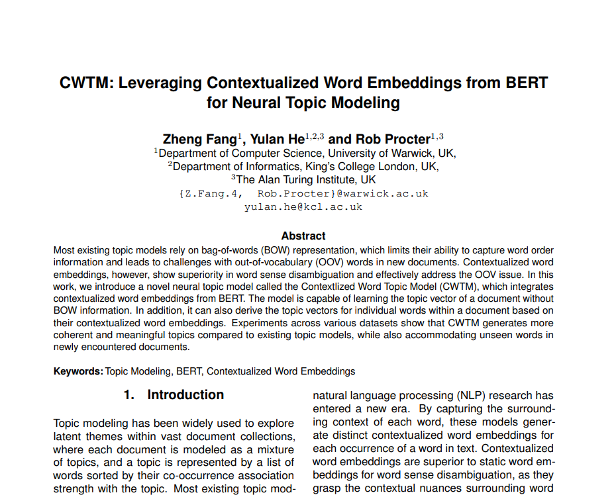
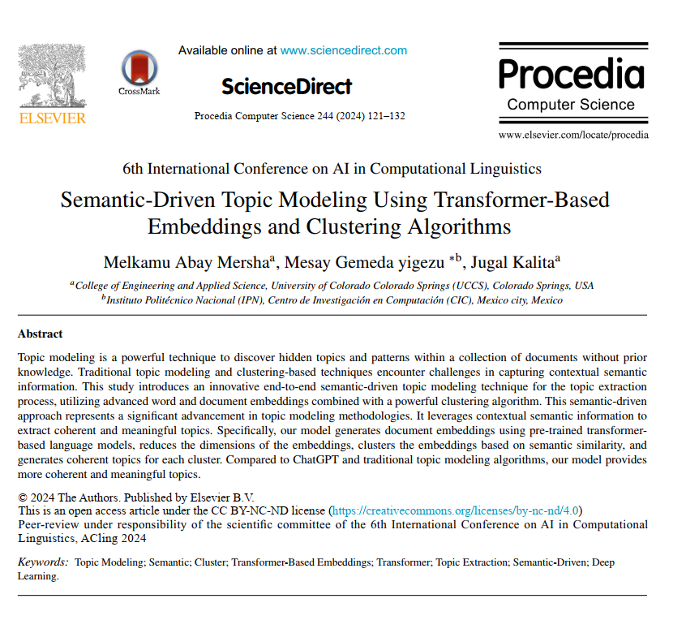
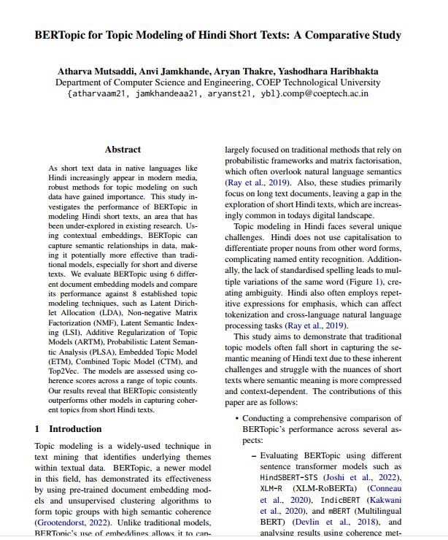
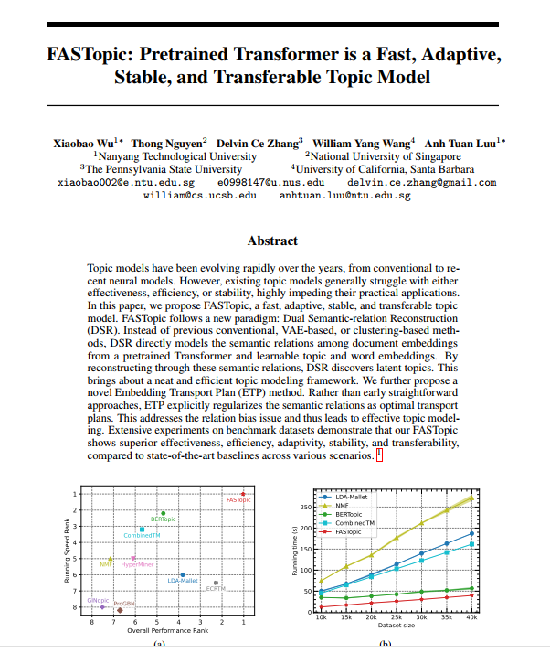
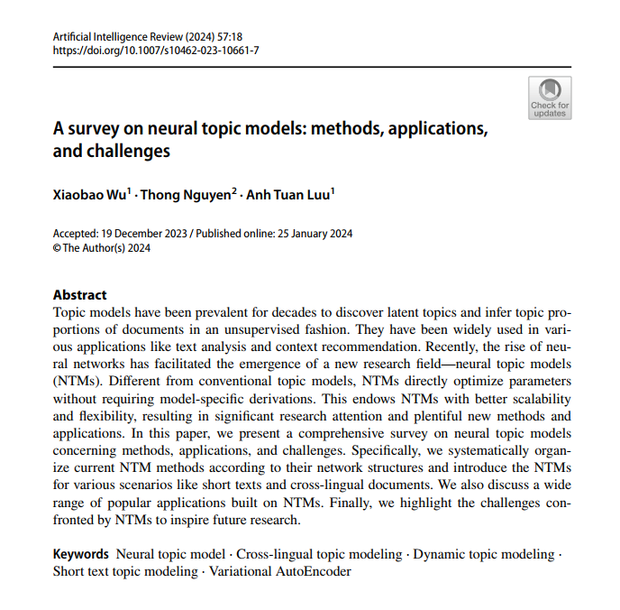
Literature review

Slide 15
Semantic-Driven Topic Modeling Using Transformer-Based Embeddings and Clustering Algorithms
Mersha, M. A., Yigezu, M. G., & Kalita, J. (2024). Semantic-Driven Topic Modeling Using Transformer-Based Embeddings and Clustering Algorithms. Procedia Computer Science, 244, 121–132.
Main objective of the article: This article addresses the key limitation of traditional Topic Modeling methods: the inability to comprehend context-dependent meaning. Methods such as LDA operate solely based on word co-occurrence and fail to capture conceptual semantics. Even certain Transformer-based models do not fully utilize the linguistic understanding power of these models in the final stage of topic extraction.
Proposed Method Architecture:
Unsupervised Pipeline :
Document Embedding
Dimension Reduction
Document Clustering
Topic Extraction
Key Results: The proposed model demonstrated significantly better performance across all metrics for topic coherence compared to BERTopic and traditional models. The model's output generated interpretable and meaningful topics.
Strengths of the Method:
Semantic-centric: Focuses on the concept of words rather than their repetition.
Modular design
Unsupervised
Automatic noise removal and outlier data management
Controllability: Users can adjust the similarity threshold to merge or separate topics.
Weaknesses or Limitations:
High computational cost
Sensitivity to parameters
Failure to identify hidden subtopics: Weakness in discovering topics embedded within the text.
Limited scope of evaluation: Other metrics, such as topic diversity, were less explored, with the main focus being on coherence.

Slide 16
CWTM: Leveraging Contextualized Word Embeddings from BERT for Neural Topic Modeling
Zheng Fang1, Yulan He1,2,3 and Rob Procter1,3 1Department of Computer Science, University of Warwick, UK, 2Department of Informatics, King’s College London, UK, 3The Alan Turing Institute, UK
Main objective of the article: This article introduces a new Topic Modeling model called CWTM, which leverages Contextualized Word Embeddings from the BERT language model to overcome the limitations of classic Bag-of-Words (BOW)-based Topic Modeling. The primary goal is to improve topic coherence, manage the vocabulary, and extract more meaningful topics without relying on BOW representation.
Strengths of the Method:
Independence from BOW
Utilization of Contextualized Embeddings
Robustness against novel vocabulary
Higher topic coherence and diversity
Weaknesses or Limitations:
Dependence on a pre-trained model
Complexity of parameter tuning
Limited interpretability
Dependence on the quality of BERT embeddings
Proposed Method Architecture: The CWTM model consists of 4 stages:
Data Preparation
Extracting Contextualized Word Embeddings
Learning Topic Vectors for Each Word
Constructing Document Topic Vector
Learning Document Representation Vector
Reconstruction and Distribution Matching
Multi-Objective Training
Topic Extraction
Key Results: By eliminating reliance on BOW and directly utilizing Contextualized Word Embeddings, the model not only generates more coherent and diverse topics, but also demonstrates greater robustness when faced with novel data and unfamiliar vocabulary. This approach can also lead to improved performance in practical applications.

Slide 17
FASTopic: Pretrained Transformer is a Fast, Adaptive, Stable, and Transferable Topic Model
Xiaobao Wu1∗ Thong Nguyen2 Delvin Ce Zhang3 William Yang Wang4 Anh Tuan Luu 2024
Main Objective of the Article: To propose a novel topic model called FASTopic, which consists of two core components: Dual Semantic-relation Reconstruction and Embedding Transport Plan. Instead of relying on classical methods, it directly models the semantic relationships between documents, topics, and words—aiming to uncover hidden topics in texts with enhanced speed, adaptability, stability, transferability, and efficiency.
Proposed method architecture:
Document Embedding Extraction
Random Initialization of Topic and Word Embeddings
Dual Semantic-Relation Modeling via Optimal Transport
Document Reconstruction via Semantic Relations
Joint Optimization
Inference for New Documents
Strengths of the method:
Very high execution speed
Better performance in Topic Coherence and Topic Diversity metrics
High stability
Simple architecture
Weaknesses or limitations:
Dependence on a pre-trained model
Limitation in processing long documents
High memory consumption
Lack of support for multilingual documents
Initial parameter tuning
Key results: The article demonstrates that FASTopic significantly outperforms leading models across all evaluation metrics—including topic quality, document-topic distribution quality, execution speed, stability, transferability, and overall performance—while delivering an optimal balance between efficiency, speed, and stability.

Slide 18
BERTopic for Topic Modeling of Hindi Short Texts: A Comparative Study
Atharva Mutsaddi, Anvi Jamkhande, Aryan Thakre, Yashodhara Haribhakta
Department of Computer Science and Engineering, COEP Technological University {atharvaam21, jamkhandeaa21, aryanst21, ybl}.comp@coeptech.ac.in
Main objective of the article: This article evaluates the effectiveness of the BERTopic model for topic modeling in Hindi short texts and compares it with other classical and modern methods to demonstrate its superiority in addressing specific linguistic challenges of Hindi, such as the absence of capital letters, non-standard spelling, and repetitive emphatic phrases.
Weaknesses or limitations:
Data limitation and the use of a single dataset
Topic bias in the dataset
Exclusive focus on short texts and lack of testing the model on longer documents
Lack of multilingual support
Strengths of the method:
Focus on low-resource languages
Comprehensive comparison
Qualitative analysis
Multiple embedding evaluation
Qualitative cluster analysis
Proposed method architecture:
Document embedding extraction
Dimensionality reduction
Clustering
Topic extraction
Evaluation
Key results: BERTopic with mBERT-Uncased embeddings consistently outperformed all compared models in topic modeling for Hindi short texts and was able to extract more coherent and meaningful topics even in the presence of specific linguistic challenges of Hindi.

Slide 19
A survey on neural topic models: methods, applications, and challenges
Xiaobao Wu1 · Thong Nguyen2 · Anh Tuan Luu1
Accepted: 19 December 2023 / Published online: 25 January 2024
© The Author(s) 2024
Main objective of the article: The article provides a comprehensive and up-to-date survey of Neural Topic Models (NTMs). It begins by comparing NTMs with classical topic models such as LDA, emphasizing the advantages of NTMs in terms of flexibility, scalability, and the absence of model-specific inference requirements.
Strengths of NTMs:
High flexibility
Scalability
Integration with advanced neural architectures
Effectiveness in complex scenarios
Gradient-based learning
Categories reviewed in the article:
Based on application scenarios:
Hierarchical NTMs
Short Text NTMs
Cross-lingual NTMs
Dynamic NTMs
Correlated NTMs
Lifelong NTMs
Categories reviewed in the article:
Based on different neural architectures:
NTMs with Various Priors
NTMs with Embeddings
NTMs with Metadata
NTMs with Graph Neural Networks
NTMs with Generative Adversarial Networks
NTMs with Pre-trained Language Models
NTMs with Contrastive Learning
NTMs with Reinforcement Learning
Topic Discovery by Clustering
Weaknesses or limitations of NTMs:
Low quality of generated topics
Sensitivity to hyperparameters
Lack of standard and reliable evaluation metrics
Data volume dependency – better performance with large datasets
Key results: By presenting a structured survey, the article demonstrates that NTMs have made significant advancements in flexibility, scalability, and integration with neural architectures. The article suggests that future efforts should focus on improving topic quality, standardizing evaluation, and reducing sensitivity to parameters.

Slide 20





Research Directions: Evolutions and the Future
Research in Transformer-based topic modeling is pursued along five main streams, each focusing on a specific aspect of this technology.
Stream 5
Human-in-the-Loop and Interactive Topic Modeling (Integration with human feedback)
1
Stream 4
2
Dynamic and Temporal Topic Modeling (Modeling topic evolution over time)
Stream 3
3
End-to-End Transformer Topic Models – Unified topic modeling
Stream 2
4
Neural Topic Models with Contextual Embeddings (Combining NTMs with BERT)
Stream 1
5
Replacing Bag-of-Words with semantic embeddings (BERTopic, Top2Vec)

Slide 21

Challenges and Research Gaps
Despite significant progress, this field still faces challenges that shape the trajectory of future research.
Research Gaps
Lack of a Standard Benchmark: Shortage of shared datasets, evaluation metrics, and application scenarios.
Poor Evaluation in Real-World Applications: Excessive focus on Topic Coherence and insufficient attention to business value and decision impact.
Fundamental Challenges
Absence of a formal definition of a "topic:" Makes fair comparison of models difficult.
Conflict between semantic quality and interpretability: Models with high semantic quality sometimes have lower interpretability.
Technical Challenges
Scalability for organizational data: Processing millions of documents under GPU constraints.
Topic instability: Re-running the model may lead to different topics.
Dependency on Clustering: The choice of clustering algorithm significantly impacts the output.

Slide 22





The Future of Topic Modeling: Integration with LLMs and Intelligent Systems
Potential pathways for future research in this field are moving toward more advanced applications and deeper integration with modern technologies.
Topic Modeling as Semantic Infrastructure
Usage as an intermediate layer in intelligent systems (Search, Recommendation, Knowledge Graph).
Integration with LLMs
Using LLMs for automatic labeling, merging/separating topics, and qualitative evaluation. Example: BERTopic + GPT.
Dynamic and Real-time Topic Modeling
Streaming Topic Modeling, Online Learning, and Drift-Aware Models for social media monitoring and crisis management.
Explainable & Policy-Aware Topic Models
Generating reasons for topic formation and evolution paths, suitable for policy-making and macro-level decision-making.
Domain-Specific Topic Modeling
Developing legal, financial, healthcare, and telecom models using Fine-Tuned Transformers.
Transformer-based Topic Modeling, as the new generation of topic discovery models, has successfully overcome the semantic understanding limitations of classical models. The future trajectory of this field is moving toward integration with LLMs, dynamic models, decision support systems, and domain-specific applications.

